Slide 1
Section 5
2022-02-11

Slide 2
Compiling programs for debugging
For all of the methods mentioned in this section, compile with the -g flag
It allows debuggers to give you much more useful information

Slide 3
Valgrind
Tool for profiling programs
Can be used to check potential and actual memory leaks
Very useful for making sure you don’t get weird behaviour!
Usage:
valgrind --leak-check=full <prog_name> [<prog_args>...]
Valgrind provides stacktrace to show where memory allocation or error occurred

Slide 4
Valgrind - Understanding output
==3124319== HEAP SUMMARY:
==3124319== in use at exit: 120 bytes in 1 blocks
==3124319== total heap usage: 7,382 allocs, 7,381 frees, 130,770 bytes allocated
==3124319==
==3124319== 120 bytes in 1 blocks are definitely lost in loss record 1 of 1
==3124319== at 0x483B7F3: malloc (in /usr/lib/x86_64-linux-gnu/valgrind/vgpreload_memcheck-amd64-linux.so)
==3124319== by 0x48E26C3: getdelim (iogetdelim.c:62)
==3124319== by 0x109C79: main (prog3.c:164)
==3124319==
==3124319== LEAK SUMMARY:
==3124319== definitely lost: 120 bytes in 1 blocks
==3124319== indirectly lost: 0 bytes in 0 blocks
==3124319== possibly lost: 0 bytes in 0 blocks
==3124319== still reachable: 0 bytes in 0 blocks
==3124319== suppressed: 0 bytes in 0 blocks
==3124319==
==3124319== For lists of detected and suppressed errors, rerun with: -s
==3124319== ERROR SUMMARY: 1 errors from 1 contexts (suppressed: 0 from 0)

Slide 5
Valgrind - Invalid reads/writes
Occur most often when you have an off-by-one error with arrays
Tell you you are trying to read/write past an allocated block
Will also show up when trying to write to/read from invalid pointers (e.g. NULL)
Invalid write of size 1
at 0x400553: main (test.c:7) <- Where the error happened
Address 0x521004a is 0 bytes after a block of size 10 alloc\'d
at 0x4C2EB6B: malloc (vg_replace_malloc.c:299)
by 0x400538: main (test.c:3)<- Valgrind guesses you were trying to access memory allocated here
int main(void)
{
char *str = malloc(sizeof(char) * 10);
int i = 0;
while (i <= 10) {
str[i] = '\0';
i = i + 1;
}
free(str);
return (0);
}

Slide 6
Valgrind - Use of uninitialized values
Occurs when you are trying to use a value you haven’t assigned a value to
Often won’t notice when running program but can cause issues with reproducibility
Conditional jump or move depends on uninitialised value(s)
at 0x4004E3: main (test.c:5)
int main(void)
{
int i;
if (i == 0) {
my_printf("Hello\n");
}
return (0);
}

Slide 7
Valgrind - Illegal free
Covers double frees, frees of memory you did not allocate etc.
Invalid free() / delete / delete[] / realloc()
at 0x4C2FD18: free (vg_replace_malloc.c:530)
by 0x400554: main (test.c:10) <- Where it was freed for a second time
Address 0x5210040 is 0 bytes inside a block of size 54 free\'d
at 0x4C2FD18: free (vg_replace_malloc.c:530)
by 0x400548: main (test.c:9) <- Where it was first freed
Block was alloc\'d at
at 0x4C2EB6B: malloc (vg_replace_malloc.c:299)
by 0x400538: main (test.c:7) <- Where the memory was allocated
int main(void)
{
char *buff = malloc(sizeof(char) * 54);
free(buff);
free(buff);
return (0);
}

Slide 8
Valgrind - other errors and references
http://cs.ecs.baylor.edu/~donahoo/tools/valgrind/messages.html
https://epitech-2022-technical-documentation.readthedocs.io/en/latest/valgrind.html
Google the error - you will probably find a lot of people with a similar issue

Slide 9
Some observed struggles
Returning values via pointers
bool stack_pop(Stack *s, CalculatorItem *output)
How can we return a value to the parent program via the output pointer?
Output is a local variable that contains a memory address
We want to set the memory at the address stored in the local variable

Slide 10
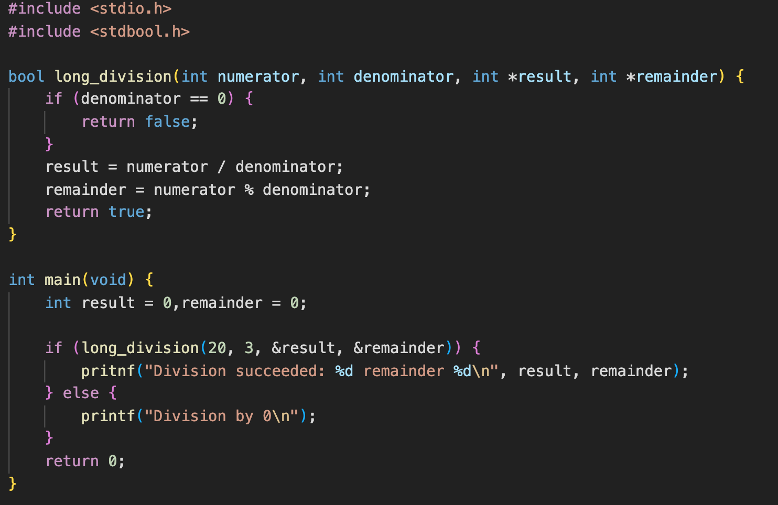
What is the issue here?
How can we ensure we correctly set the result and remainder?

Slide 11
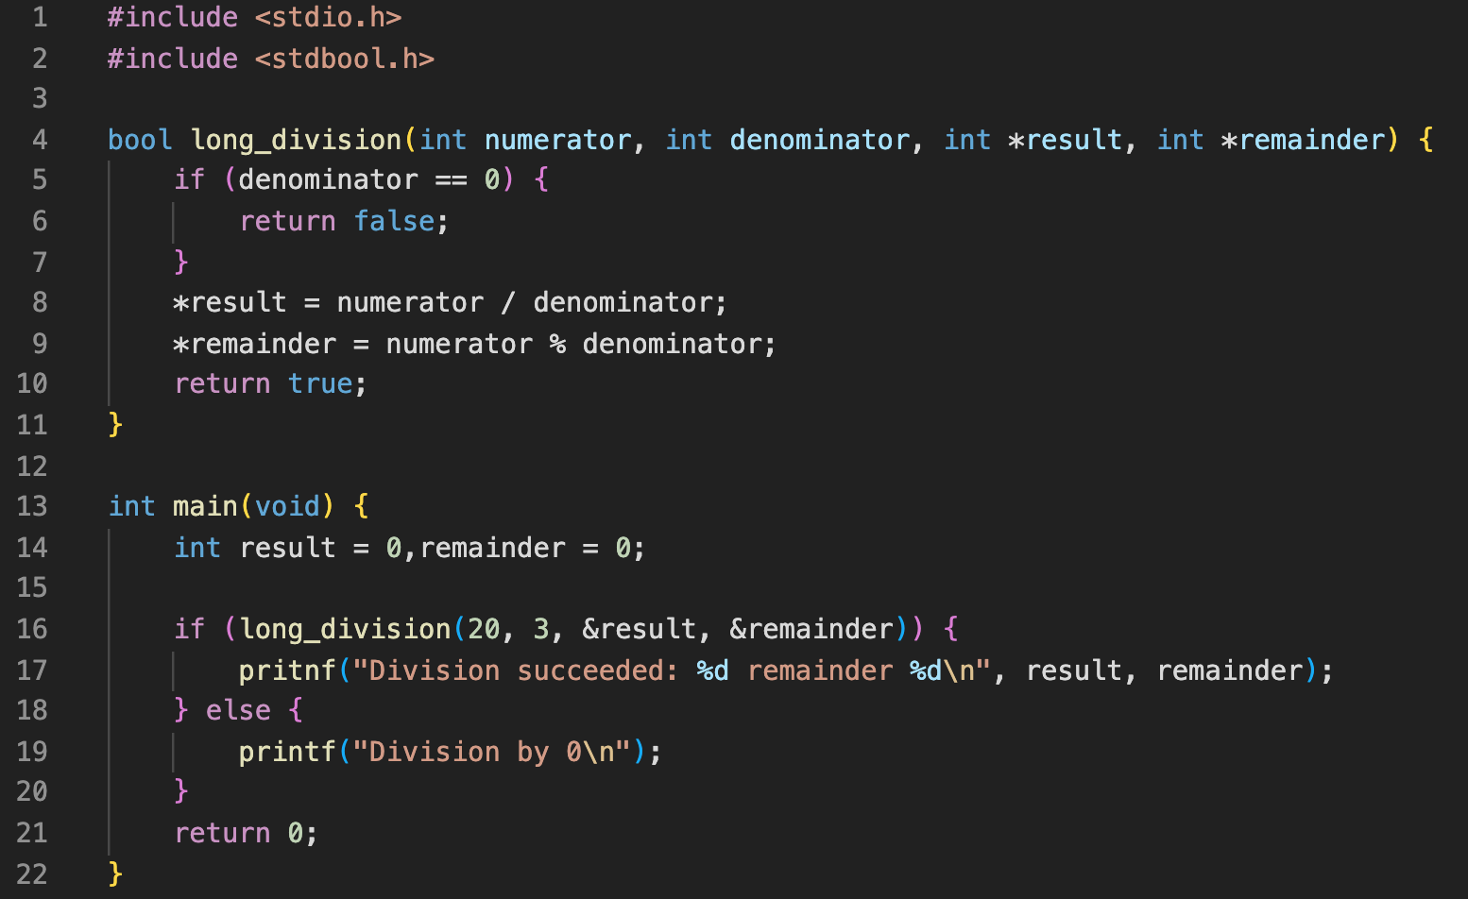
Returning via pointers
Stack
Variable value
Variable Address
main:result
0
0xff1c
main:remainder
0
0xff18

Slide 12
Returning via pointers
Stack
Variable value
Variable Address
main:result
0
0xff1c
main:remainder
0
0xff18

Slide 13
Returning via pointers
Stack
Variable value
Variable Address
main:result
0
0xff1c
main:remainder
0
0xff18
long_division:numerator
20
0xff14
long_division:denominator
3
0xff10
long_division:result
0xff1c
0xff02
long_division:remainder
0xff18
0xfefa

Slide 14
Returning via pointers
Stack
Variable value
Variable Address
main:result
0
0xff1c
main:remainder
0
0xff18
long_division:numerator
20
0xff14
long_division:denominator
3
0xff10
long_division:result
0xff1c
0xff02
long_division:remainder
0xff18
0xfefa

Slide 15
Returning via pointers
Stack
Variable value
Variable Address
main:result
6
0xff1c
main:remainder
0
0xff18
long_division:numerator
20
0xff14
long_division:denominator
3
0xff10
long_division:result
0xff1c
0xff02
long_division:remainder
0xff18
0xfefa

Slide 16
Returning via pointers
Stack
Variable value
Variable Address
main:result
6
0xff1c
main:remainder
2
0xff18
long_division:numerator
20
0xff14
long_division:denominator
3
0xff10
long_division:result
0xff1c
0xff02
long_division:remainder
0xff18
0xfefa

Slide 17
Returning via pointers
Stack
Variable value
Variable Address
main:result
6
0xff1c
main:remainder
2
0xff18
long_division:numerator
20
0xff14
long_division:denominator
3
0xff10
long_division:result
0xff1c
0xff02
long_division:remainder
0xff18
0xfefa

Slide 18
Returning via pointers
Stack
Variable value
Variable Address
main:result
6
0xff1c
main:remainder
2
0xff18

Slide 19
Returning via pointers
Stack
Variable value
Variable Address
main:result
6
0xff1c
main:remainder
2
0xff18

Slide 20
Returning via pointers
Stack
Variable value
Variable Address
main:result
6
0xff1c
main:remainder
2
0xff18

Slide 21
Returning via pointers
Stack
Variable value
Variable Address
main:result
6
0xff1c
main:remainder
2
0xff18

Slide 22
Returning via pointers
Stack
Variable value
Variable Address

Slide 23
What would have this looked like with faulty code?

Slide 24
Returning via pointers - Faulty
Stack
Variable value
Variable Address
main:result
0
0xff1c
main:remainder
0
0xff18
long_division:numerator
20
0xff14
long_division:denominator
3
0xff10
long_division:result
6
0xff02
long_division:remainder
0xff18
0xfefa

Slide 25
Returning via pointers - Faulty
Stack
Variable value
Variable Address
main:result
0
0xff1c
main:remainder
0
0xff18
long_division:numerator
20
0xff14
long_division:denominator
3
0xff10
long_division:result
6
0xff02
long_division:remainder
2
0xfefa

Slide 26
Returning via pointers
Stack
Variable value
Variable Address
main:result
0
0xff1c
main:remainder
0
0xff18

Slide 27
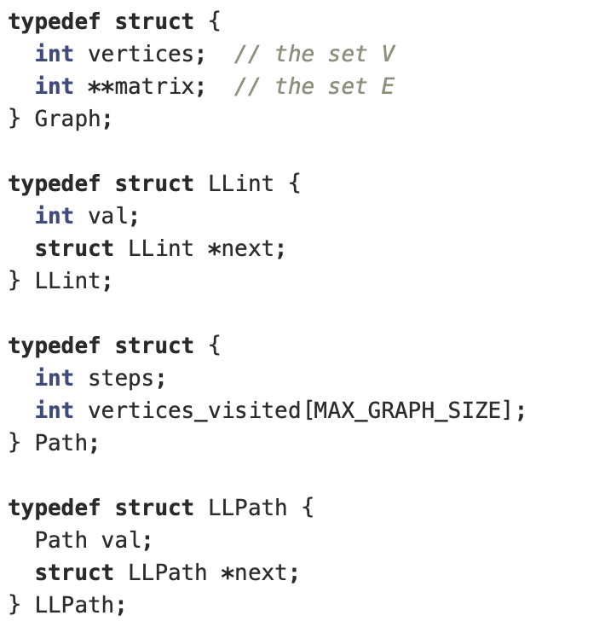
Hwk4
Some small pointers:
Matrix is a 2 dimensional array (hence why 2 pointers)
Specific cell can be accessed by: matrix[x][y]
Lots of LL - What does LL stand for?
Linked list
These look very similar to Nodes in the previous hwk
Why do we need 2?
Look at the types of the values they store

Slide 28
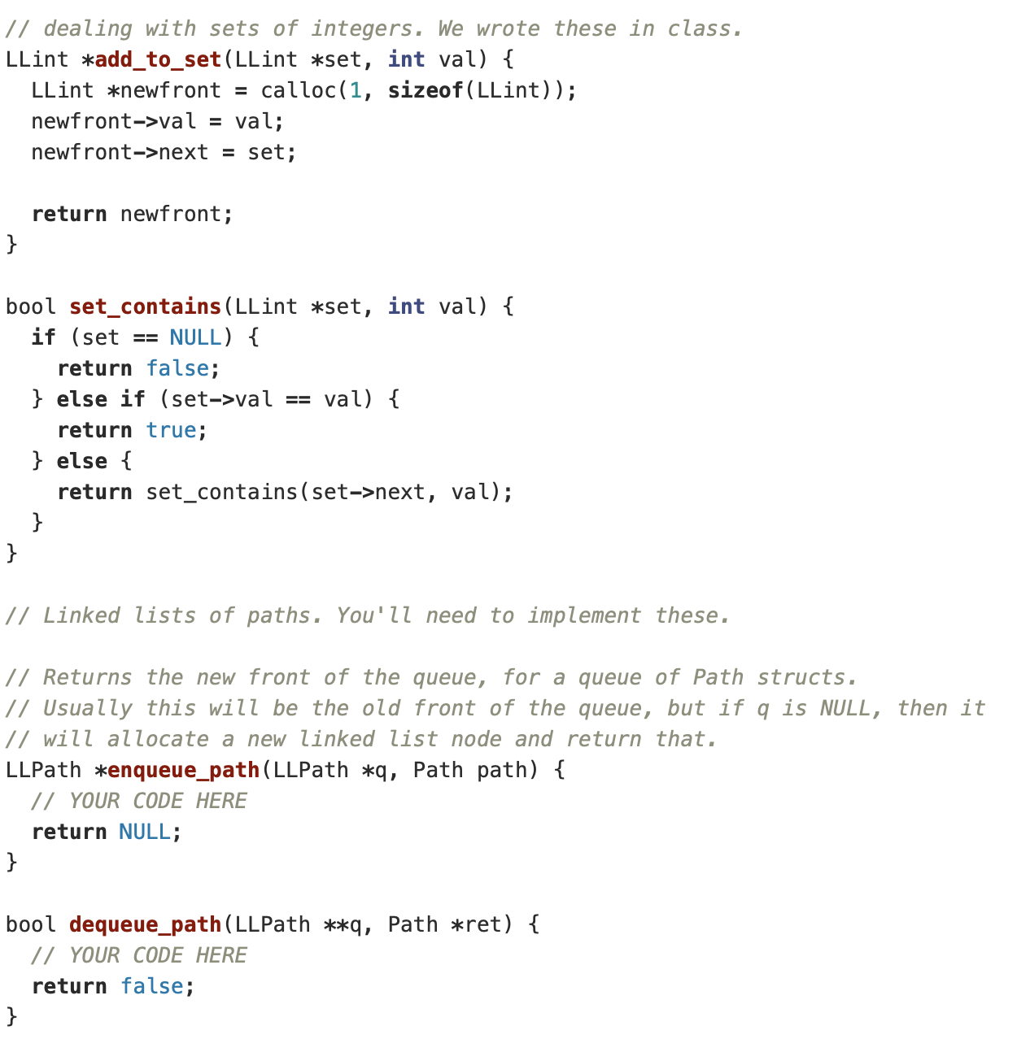
Hwk4
enqueue_path looks pretty similar to what add_to_set does
What will be the difference?
dequeue_path has a pointer to a pointer
What is the purpose of the first pointer?
What is the purpose of the second?
Similar pattern for access was seen in stack_delete
Why did we have to have 2 levels of pointers then?
What is ret short for?
We have seen a similar pattern in previous hwk

Slide 29
Hwk4
Here is a visualisation in the meantime: https://visualgo.net/en/dfsbfs

Slide 30
Setting up a graph
Let's start by creating a graph
6 // Number of vertices in graph
0 5 // Start and end vertices
0 1 //Adds an edge
0 2 //Adds an edge
0 4 //Adds an edge
1 0 //Adds an edge
1 2 //Adds an edge
2 3 //Adds an edge
2 5 //Adds an edge
3 4 //Adds an edge
4 5 //Adds an edge
0
4
5
1
2
3

Slide 31
Breadth First Search

Slide 32
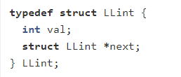
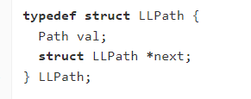
BFS
Target node: 5
keep a set of vertices that we have visited
keep a queue of vertices that we want to visit
put the starting vertex into the queue
while there are more places to visit in the queue:
dequeue the next place to visit
see if it is our intended destination -- if it is, return success!
otherwise, add to set of visited nodes if not in set
enqueue each of its neighbors that have not been visited
return false if the queue becomes empty (we ran out of options)
Visited set
Exploration queue (FIFO)
[0]
0
4
5
1
2
3
Being explored:

Slide 33
BFS
Target node: 5
keep a set of vertices that we have visited
keep a queue of vertices that we want to visit
put the starting vertex into the queue
while there are more places to visit in the queue:
dequeue the next place to visit
see if it is our intended destination -- if it is, return success!
otherwise, add to set of visited nodes if not in set
enqueue each of its neighbors that have not been visited
return false if the queue becomes empty (we ran out of options)
Visited set
Exploration queue (FIFO)
[0]
0
4
5
1
2
3
Being explored:

Slide 34
BFS
Target node: 5
keep a set of vertices that we have visited
keep a queue of vertices that we want to visit
put the starting vertex into the queue
while there are more places to visit in the queue:
dequeue the next place to visit
see if it is our intended destination -- if it is, return success!
otherwise, add to set of visited nodes if not in set
enqueue each of its neighbors that have not been visited
return false if the queue becomes empty (we ran out of options)
Visited set
Exploration queue (FIFO)
Dequeue
0
4
5
1
2
3
Being explored:
[0]

Slide 35
BFS
Target node: 5
keep a set of vertices that we have visited
keep a queue of vertices that we want to visit
put the starting vertex into the queue
while there are more places to visit in the queue:
dequeue the next place to visit
see if it is our intended destination -- if it is, return success!
otherwise, add to set of visited nodes if not in set
enqueue each of its neighbors that have not been visited
return false if the queue becomes empty (we ran out of options)
Visited set
Exploration queue (FIFO)
0
4
5
1
2
3
Being explored:
[0]

Slide 36
BFS
Target node: 5
keep a set of vertices that we have visited
keep a queue of vertices that we want to visit
put the starting vertex into the queue
while there are more places to visit in the queue:
dequeue the next place to visit
see if it is our intended destination -- if it is, return success!
otherwise, add to set of visited nodes if not in set
enqueue each of its neighbors that have not been visited
return false if the queue becomes empty (we ran out of options)
Visited set
Exploration queue (FIFO)
0
0
4
5
1
2
3
Being explored:
[0]

Slide 37
BFS
Target node: 5
keep a set of vertices that we have visited
keep a queue of vertices that we want to visit
put the starting vertex into the queue
while there are more places to visit in the queue:
dequeue the next place to visit
see if it is our intended destination -- if it is, return success!
otherwise, add to set of visited nodes if not in set
enqueue each of its neighbors that have not been visited
return false if the queue becomes empty (we ran out of options)
Visited set
Exploration queue (FIFO)
0
Enqueue 1
[0, 1]
[0, 2]
Enqueue 2
Enqueue 3
[0, 4]
0
4
5
1
2
3
Being explored:
[0]

Slide 38
BFS
Target node: 5
keep a set of vertices that we have visited
keep a queue of vertices that we want to visit
put the starting vertex into the queue
while there are more places to visit in the queue:
dequeue the next place to visit
see if it is our intended destination -- if it is, return success!
otherwise, add to set of visited nodes if not in set
enqueue each of its neighbors that have not been visited
return false if the queue becomes empty (we ran out of options)
Visited set
Exploration queue (FIFO)
0
[0, 1]
[0, 2]
[0, 4]
0
4
5
1
2
3
Being explored:

Slide 39
BFS
Target node: 5
keep a set of vertices that we have visited
keep a queue of vertices that we want to visit
put the starting vertex into the queue
while there are more places to visit in the queue:
dequeue the next place to visit
see if it is our intended destination -- if it is, return success!
otherwise, add to set of visited nodes if not in set
enqueue each of its neighbors that have not been visited
return false if the queue becomes empty (we ran out of options)
Visited set
Exploration queue (FIFO)
0
Dequeue
[0, 2]
[0, 4]
0
4
5
1
2
3
Being explored:
[0, 1]

Slide 40
BFS
Target node: 5
keep a set of vertices that we have visited
keep a queue of vertices that we want to visit
put the starting vertex into the queue
while there are more places to visit in the queue:
dequeue the next place to visit
see if it is our intended destination -- if it is, return success!
otherwise, add to set of visited nodes if not in set
enqueue each of its neighbors that have not been visited
return false if the queue becomes empty (we ran out of options)
Visited set
Exploration queue (FIFO)
0
[0, 2]
[0, 4]
0
4
5
1
2
3
Being explored:
[0, 1]

Slide 41
BFS
Target node: 5
keep a set of vertices that we have visited
keep a queue of vertices that we want to visit
put the starting vertex into the queue
while there are more places to visit in the queue:
dequeue the next place to visit
see if it is our intended destination -- if it is, return success!
otherwise, add to set of visited nodes if not in set
enqueue each of its neighbors that have not been visited
return false if the queue becomes empty (we ran out of options)
Visited set
Exploration queue (FIFO)
0
1
[0, 2]
[0, 4]
0
4
5
1
2
3
Being explored:
[0, 1]

Slide 42
BFS
Target node: 5
keep a set of vertices that we have visited
keep a queue of vertices that we want to visit
put the starting vertex into the queue
while there are more places to visit in the queue:
dequeue the next place to visit
see if it is our intended destination -- if it is, return success!
otherwise, add to set of visited nodes if not in set
enqueue each of its neighbors that have not been visited
return false if the queue becomes empty (we ran out of options)
Visited set
Exploration queue (FIFO)
0
1
[0, 2]
[0, 4]
[0, 1, 2]
0
4
5
1
2
3
Being explored:
[0, 1]

Slide 43
BFS
Target node: 5
keep a set of vertices that we have visited
keep a queue of vertices that we want to visit
put the starting vertex into the queue
while there are more places to visit in the queue:
dequeue the next place to visit
see if it is our intended destination -- if it is, return success!
otherwise, add to set of visited nodes if not in set
enqueue each of its neighbors that have not been visited
return false if the queue becomes empty (we ran out of options)
Visited set
Exploration queue (FIFO)
0
1
[0, 2]
[0, 4]
[0, 1, 2]
0
4
5
1
2
3
Being explored:

Slide 44
BFS
Target node: 5
keep a set of vertices that we have visited
keep a queue of vertices that we want to visit
put the starting vertex into the queue
while there are more places to visit in the queue:
dequeue the next place to visit
see if it is our intended destination -- if it is, return success!
otherwise, add to set of visited nodes if not in set
enqueue each of its neighbors that have not been visited
return false if the queue becomes empty (we ran out of options)
Visited set
Exploration queue (FIFO)
0
Dequeue
1
[0, 4]
[0, 1, 2]
0
4
5
1
2
3
Being explored:
[0, 2]

Slide 45
BFS
Target node: 5
keep a set of vertices that we have visited
keep a queue of vertices that we want to visit
put the starting vertex into the queue
while there are more places to visit in the queue:
dequeue the next place to visit
see if it is our intended destination -- if it is, return success!
otherwise, add to set of visited nodes if not in set
enqueue each of its neighbors that have not been visited
return false if the queue becomes empty (we ran out of options)
Visited set
Exploration queue (FIFO)
0
1
[0, 4]
[0, 1, 2]
0
4
5
1
2
3
Being explored:
[0, 2]

Slide 46
BFS
Target node: 5
keep a set of vertices that we have visited
keep a queue of vertices that we want to visit
put the starting vertex into the queue
while there are more places to visit in the queue:
dequeue the next place to visit
see if it is our intended destination -- if it is, return success!
otherwise, add to set of visited nodes if not in set
enqueue each of its neighbors that have not been visited
return false if the queue becomes empty (we ran out of options)
Visited set
Exploration queue (FIFO)
0
1
2
[0, 4]
[0, 1, 2]
0
4
5
1
2
3
Being explored:
[0, 2]

Slide 47
BFS
Target node: 5
keep a set of vertices that we have visited
keep a queue of vertices that we want to visit
put the starting vertex into the queue
while there are more places to visit in the queue:
dequeue the next place to visit
see if it is our intended destination -- if it is, return success!
otherwise, add to set of visited nodes if not in set
enqueue each of its neighbors that have not been visited
return false if the queue becomes empty (we ran out of options)
Visited set
Exploration queue (FIFO)
0
1
2
[0, 4]
[0, 1, 2]
[0, 2, 3]
0
4
5
[0, 2, 5]
1
2
3
Being explored:
[0, 2]

Slide 48
BFS
Target node: 5
keep a set of vertices that we have visited
keep a queue of vertices that we want to visit
put the starting vertex into the queue
while there are more places to visit in the queue:
dequeue the next place to visit
see if it is our intended destination -- if it is, return success!
otherwise, add to set of visited nodes if not in set
enqueue each of its neighbors that have not been visited
return false if the queue becomes empty (we ran out of options)
Visited set
Exploration queue (FIFO)
0
1
2
[0, 4]
[0, 1, 2]
[0, 2, 3]
0
4
5
[0, 2, 5]
1
2
3
Being explored:

Slide 49
BFS
Target node: 5
keep a set of vertices that we have visited
keep a queue of vertices that we want to visit
put the starting vertex into the queue
while there are more places to visit in the queue:
dequeue the next place to visit
see if it is our intended destination -- if it is, return success!
otherwise, add to set of visited nodes if not in set
enqueue each of its neighbors that have not been visited
return false if the queue becomes empty (we ran out of options)
Visited set
Exploration queue (FIFO)
0
Dequeue
1
2
[0, 1, 2]
[0, 2, 3]
[0, 2, 5]
0
4
5
1
2
3
Being explored:
[0, 4]

Slide 50
BFS
Target node: 5
keep a set of vertices that we have visited
keep a queue of vertices that we want to visit
put the starting vertex into the queue
while there are more places to visit in the queue:
dequeue the next place to visit
see if it is our intended destination -- if it is, return success!
otherwise, add to set of visited nodes if not in set
enqueue each of its neighbors that have not been visited
return false if the queue becomes empty (we ran out of options)
Visited set
Exploration queue (FIFO)
0
1
2
[0, 1, 2]
[0, 2, 3]
[0, 2, 5]
0
4
5
1
2
3
Being explored:
[0, 4]

Slide 51
BFS
Target node: 5
keep a set of vertices that we have visited
keep a queue of vertices that we want to visit
put the starting vertex into the queue
while there are more places to visit in the queue:
dequeue the next place to visit
see if it is our intended destination -- if it is, return success!
otherwise, add to set of visited nodes if not in set
enqueue each of its neighbors that have not been visited
return false if the queue becomes empty (we ran out of options)
Visited set
Exploration queue (FIFO)
0
1
2
[0, 1, 2]
4
[0, 2, 3]
[0, 2, 5]
0
4
5
1
2
3
Being explored:
[0, 4]

Slide 52
BFS
Target node: 5
keep a set of vertices that we have visited
keep a queue of vertices that we want to visit
put the starting vertex into the queue
while there are more places to visit in the queue:
dequeue the next place to visit
see if it is our intended destination -- if it is, return success!
otherwise, add to set of visited nodes if not in set
enqueue each of its neighbors that have not been visited
return false if the queue becomes empty (we ran out of options)
Visited set
Exploration queue (FIFO)
0
1
2
[0, 1, 2]
4
[0, 2, 3]
[0, 2, 5]
0
4
5
[0, 4, 5]
1
2
3
Being explored:
[0, 4]

Slide 53
BFS
Target node: 5
keep a set of vertices that we have visited
keep a queue of vertices that we want to visit
put the starting vertex into the queue
while there are more places to visit in the queue:
dequeue the next place to visit
see if it is our intended destination -- if it is, return success!
otherwise, add to set of visited nodes if not in set
enqueue each of its neighbors that have not been visited
return false if the queue becomes empty (we ran out of options)
Visited set
Exploration queue (FIFO)
0
1
2
[0, 1, 2]
4
[0, 2, 3]
[0, 2, 5]
0
4
5
[0, 4, 5]
1
2
3
Being explored:

Slide 54
BFS
Target node: 5
keep a set of vertices that we have visited
keep a queue of vertices that we want to visit
put the starting vertex into the queue
while there are more places to visit in the queue:
dequeue the next place to visit
see if it is our intended destination -- if it is, return success!
otherwise, add to set of visited nodes if not in set
enqueue each of its neighbors that have not been visited
return false if the queue becomes empty (we ran out of options)
Visited set
Exploration queue (FIFO)
0
Dequeue
1
2
[0, 2, 3]
4
[0, 2, 5]
[0, 4, 5]
0
4
5
1
2
3
Being explored:
[0, 1, 2]

Slide 55
BFS
Target node: 5
keep a set of vertices that we have visited
keep a queue of vertices that we want to visit
put the starting vertex into the queue
while there are more places to visit in the queue:
dequeue the next place to visit
see if it is our intended destination -- if it is, return success!
otherwise, add to set of visited nodes if not in set
enqueue each of its neighbors that have not been visited
return false if the queue becomes empty (we ran out of options)
Visited set
Exploration queue (FIFO)
0
1
2
[0, 2, 3]
4
[0, 2, 5]
[0, 4, 5]
0
4
5
1
2
3
Being explored:
[0, 1, 2]

Slide 56
BFS
Target node: 5
keep a set of vertices that we have visited
keep a queue of vertices that we want to visit
put the starting vertex into the queue
while there are more places to visit in the queue:
dequeue the next place to visit
see if it is our intended destination -- if it is, return success!
otherwise, add to set of visited nodes if not in set
enqueue each of its neighbors that have not been visited
return false if the queue becomes empty (we ran out of options)
Visited set
Exploration queue (FIFO)
0
1
2
[0, 2, 3]
4
[0, 2, 5]
[0, 4, 5]
0
4
5
1
2
3
Being explored:
[0, 1, 2]

Slide 57
BFS
Target node: 5
keep a set of vertices that we have visited
keep a queue of vertices that we want to visit
put the starting vertex into the queue
while there are more places to visit in the queue:
dequeue the next place to visit
see if it is our intended destination -- if it is, return success!
otherwise, add to set of visited nodes
enqueue each of its neighbors that have not been visited
return false if the queue becomes empty (we ran out of options)
Visited set
Exploration queue (FIFO)
0
1
2
[0, 2, 3]
4
[0, 2, 5]
[0, 4, 5]
0
4
5
[0, 1, 2, 3]
[0, 1, 2, 5]
1
2
3
Being explored:
[0, 1, 2]

Slide 58
BFS
Target node: 5
keep a set of vertices that we have visited
keep a queue of vertices that we want to visit
put the starting vertex into the queue
while there are more places to visit in the queue:
dequeue the next place to visit
see if it is our intended destination -- if it is, return success!
otherwise, add to set of visited nodes
enqueue each of its neighbors that have not been visited
return false if the queue becomes empty (we ran out of options)
Visited set
Exploration queue (FIFO)
0
1
2
[0, 2, 3]
4
[0, 2, 5]
[0, 4, 5]
0
4
5
[0, 1, 2, 3]
[0, 1, 2, 5]
1
2
3
Being explored:

Slide 59
BFS
Target node: 5
keep a set of vertices that we have visited
keep a queue of vertices that we want to visit
put the starting vertex into the queue
while there are more places to visit in the queue:
dequeue the next place to visit
see if it is our intended destination -- if it is, return success!
otherwise, add to set of visited nodes
enqueue each of its neighbors that have not been visited
return false if the queue becomes empty (we ran out of options)
Visited set
Exploration queue (FIFO)
0
Dequeue
1
2
[0, 2, 5]
4
[0, 4, 5]
[0, 1, 2, 3]
0
4
5
[0, 1, 2, 5]
1
2
3
Being explored:
[0, 2, 3]

Slide 60
BFS
Target node: 5
keep a set of vertices that we have visited
keep a queue of vertices that we want to visit
put the starting vertex into the queue
while there are more places to visit in the queue:
dequeue the next place to visit
see if it is our intended destination -- if it is, return success!
otherwise, add to set of visited nodes
enqueue each of its neighbors that have not been visited
return false if the queue becomes empty (we ran out of options)
Visited set
Exploration queue (FIFO)
0
1
2
[0, 2, 5]
4
[0, 4, 5]
[0, 1, 2, 3]
0
4
5
[0, 1, 2, 5]
1
2
3
Being explored:
[0, 2, 3]

Slide 61
BFS
Target node: 5
keep a set of vertices that we have visited
keep a queue of vertices that we want to visit
put the starting vertex into the queue
while there are more places to visit in the queue:
dequeue the next place to visit
see if it is our intended destination -- if it is, return success!
otherwise, add to set of visited nodes
enqueue each of its neighbors that have not been visited
return false if the queue becomes empty (we ran out of options)
Visited set
Exploration queue (FIFO)
0
1
2
[0, 2, 5]
4
[0, 4, 5]
3
[0, 1, 2, 3]
0
4
5
[0, 1, 2, 5]
1
2
3
Being explored:
[0, 2, 3]

Slide 62
BFS
Target node: 5
keep a set of vertices that we have visited
keep a queue of vertices that we want to visit
put the starting vertex into the queue
while there are more places to visit in the queue:
dequeue the next place to visit
see if it is our intended destination -- if it is, return success!
otherwise, add to set of visited nodes
enqueue each of its neighbors that have not been visited
return false if the queue becomes empty (we ran out of options)
Visited set
Exploration queue (FIFO)
0
1
2
[0, 2, 5]
4
[0, 4, 5]
3
[0, 1, 2, 3]
0
4
5
[0, 1, 2, 5]
1
2
3
Being explored:
[0, 2, 3]

Slide 63
BFS
Target node: 5
keep a set of vertices that we have visited
keep a queue of vertices that we want to visit
put the starting vertex into the queue
while there are more places to visit in the queue:
dequeue the next place to visit
see if it is our intended destination -- if it is, return success!
otherwise, add to set of visited nodes
enqueue each of its neighbors that have not been visited
return false if the queue becomes empty (we ran out of options)
Visited set
Exploration queue (FIFO)
0
1
2
[0, 2, 5]
4
[0, 4, 5]
3
[0, 1, 2, 3]
0
4
5
[0, 1, 2, 5]
1
2
3
Being explored:

Slide 64
BFS
Target node: 5
keep a set of vertices that we have visited
keep a queue of vertices that we want to visit
put the starting vertex into the queue
while there are more places to visit in the queue:
dequeue the next place to visit
see if it is our intended destination -- if it is, return success!
otherwise, add to set of visited nodes
enqueue each of its neighbors that have not been visited
return false if the queue becomes empty (we ran out of options)
Visited set
Exploration queue (FIFO)
0
Dequeue
1
2
[0, 4, 5]
4
[0, 1, 2, 3]
3
[0, 1, 2, 5]
0
4
5
1
2
3
Being explored:
[0, 2, 5]

Slide 65
BFS
Target node: 5
keep a set of vertices that we have visited
keep a queue of vertices that we want to visit
put the starting vertex into the queue
while there are more places to visit in the queue:
dequeue the next place to visit
see if it is our intended destination -- if it is, return success!
otherwise, add to set of visited nodes
enqueue each of its neighbors that have not been visited
return false if the queue becomes empty (we ran out of options)
Visited set
Exploration queue (FIFO)
0
1
2
[0, 4, 5]
4
[0, 1, 2, 3]
3
[0, 1, 2, 5]
0
4
5
1
2
3
Being explored:
[0, 2, 5]

Slide 66
BFS result
What do we need to free before returning the path?
What did we create to run this algorithm?
Why does the order of enqueuing of neighbors matter?
0
4
5
1
2
3
[0, 2, 5]

Slide 67
Depth First Search

Slide 68
DFS
Target node: 5
keep a set of vertices that we have visited
keep a stack of vertices that we want to visit
put the starting vertex into the stack
while there are more places to visit in the stack:
pop the next place to visit
see if it is our intended destination -- if it is, return success!
otherwise, add to set of visited nodes if not in set
push each of its neighbors that have not been visited
return false if the queue becomes empty (we ran out of options)
Visited set
Exploration stack (LIFO)
[0]
0
4
5
1
2
3
Being explored:

Slide 69
DFS
Target node: 5
keep a set of vertices that we have visited
keep a stack of vertices that we want to visit
put the starting vertex into the stack
while there are more places to visit in the stack:
pop the next place to visit
see if it is our intended destination -- if it is, return success!
otherwise, add to set of visited nodes if not in set
push each of its neighbors that have not been visited
return false if the queue becomes empty (we ran out of options)
Visited set
Exploration stack (LIFO)
[0]
0
4
5
1
2
3
Being explored:

Slide 70
DFS
Target node: 5
keep a set of vertices that we have visited
keep a stack of vertices that we want to visit
put the starting vertex into the stack
while there are more places to visit in the stack:
pop the next place to visit
see if it is our intended destination -- if it is, return success!
otherwise, add to set of visited nodes if not in set
push each of its neighbors that have not been visited
return false if the queue becomes empty (we ran out of options)
Visited set
Exploration stack (LIFO)
Pop
0
4
5
1
2
3
Being explored:
[0]

Slide 71
DFS
Target node: 5
keep a set of vertices that we have visited
keep a stack of vertices that we want to visit
put the starting vertex into the stack
while there are more places to visit in the stack:
pop the next place to visit
see if it is our intended destination -- if it is, return success!
otherwise, add to set of visited nodes if not in set
push each of its neighbors that have not been visited
return false if the queue becomes empty (we ran out of options)
Visited set
Exploration stack (LIFO)
0
4
5
1
2
3
Being explored:
[0]

Slide 72
DFS
Target node: 5
keep a set of vertices that we have visited
keep a stack of vertices that we want to visit
put the starting vertex into the stack
while there are more places to visit in the stack:
pop the next place to visit
see if it is our intended destination -- if it is, return success!
otherwise, add to set of visited nodes if not in set
push each of its neighbors that have not been visited
return false if the queue becomes empty (we ran out of options)
Visited set
Exploration stack (LIFO)
0
0
4
5
1
2
3
Being explored:
[0]

Slide 73
DFS
Target node: 5
keep a set of vertices that we have visited
keep a stack of vertices that we want to visit
put the starting vertex into the stack
while there are more places to visit in the stack:
pop the next place to visit
see if it is our intended destination -- if it is, return success!
otherwise, add to set of visited nodes if not in set
push each of its neighbors that have not been visited
return false if the queue becomes empty (we ran out of options)
Visited set
Exploration stack (LIFO)
0
Push 3
[0, 1]
[0, 2]
Push 2
Push 1
[0, 4]
0
4
5
1
2
3
Being explored:
[0]

Slide 74
DFS
Target node: 5
keep a set of vertices that we have visited
keep a stack of vertices that we want to visit
put the starting vertex into the stack
while there are more places to visit in the stack:
pop the next place to visit
see if it is our intended destination -- if it is, return success!
otherwise, add to set of visited nodes if not in set
push each of its neighbors that have not been visited
return false if the queue becomes empty (we ran out of options)
Visited set
Exploration stack (LIFO)
0
[0, 1]
[0, 2]
[0, 4]
0
4
5
1
2
3
Being explored:

Slide 75
DFS
Target node: 5
keep a set of vertices that we have visited
keep a stack of vertices that we want to visit
put the starting vertex into the stack
while there are more places to visit in the stack:
pop the next place to visit
see if it is our intended destination -- if it is, return success!
otherwise, add to set of visited nodes if not in set
push each of its neighbors that have not been visited
return false if the queue becomes empty (we ran out of options)
Visited set
Exploration stack (LIFO)
0
Pop
[0, 2]
[0, 4]
0
4
5
1
2
3
Being explored:
[0, 1]

Slide 76
DFS
Target node: 5
keep a set of vertices that we have visited
keep a stack of vertices that we want to visit
put the starting vertex into the stack
while there are more places to visit in the stack:
pop the next place to visit
see if it is our intended destination -- if it is, return success!
otherwise, add to set of visited nodes if not in set
push each of its neighbors that have not been visited
return false if the queue becomes empty (we ran out of options)
Visited set
Exploration stack (LIFO)
0
[0, 2]
[0, 4]
0
4
5
1
2
3
Being explored:
[0, 1]

Slide 77
DFS
Target node: 5
keep a set of vertices that we have visited
keep a stack of vertices that we want to visit
put the starting vertex into the stack
while there are more places to visit in the stack:
pop the next place to visit
see if it is our intended destination -- if it is, return success!
otherwise, add to set of visited nodes if not in set
push each of its neighbors that have not been visited
return false if the queue becomes empty (we ran out of options)
Visited set
Exploration stack (LIFO)
0
1
[0, 2]
[0, 4]
0
4
5
1
2
3
Being explored:
[0, 1]

Slide 78
DFS
Target node: 5
keep a set of vertices that we have visited
keep a stack of vertices that we want to visit
put the starting vertex into the stack
while there are more places to visit in the stack:
pop the next place to visit
see if it is our intended destination -- if it is, return success!
otherwise, add to set of visited nodes if not in set
push each of its neighbors that have not been visited
return false if the queue becomes empty (we ran out of options)
Visited set
Exploration stack (LIFO)
0
1
[0, 1, 2]
[0, 2]
[0, 4]
0
4
5
1
2
3
Being explored:
[0, 1]

Slide 79
DFS
Target node: 5
keep a set of vertices that we have visited
keep a stack of vertices that we want to visit
put the starting vertex into the stack
while there are more places to visit in the stack:
pop the next place to visit
see if it is our intended destination -- if it is, return success!
otherwise, add to set of visited nodes if not in set
push each of its neighbors that have not been visited
return false if the queue becomes empty (we ran out of options)
Visited set
Exploration stack (LIFO)
0
1
[0, 1, 2]
[0, 2]
[0, 4]
0
4
5
1
2
3
Being explored:

Slide 80
DFS
Target node: 5
keep a set of vertices that we have visited
keep a stack of vertices that we want to visit
put the starting vertex into the stack
while there are more places to visit in the stack:
pop the next place to visit
see if it is our intended destination -- if it is, return success!
otherwise, add to set of visited nodes if not in set
push each of its neighbors that have not been visited
return false if the queue becomes empty (we ran out of options)
Visited set
Exploration stack (LIFO)
0
Pop
1
[0, 2]
[0, 4]
0
4
5
1
2
3
Being explored:
[0, 1, 2]

Slide 81
DFS
Target node: 5
keep a set of vertices that we have visited
keep a stack of vertices that we want to visit
put the starting vertex into the stack
while there are more places to visit in the stack:
pop the next place to visit
see if it is our intended destination -- if it is, return success!
otherwise, add to set of visited nodes if not in set
push each of its neighbors that have not been visited
return false if the queue becomes empty (we ran out of options)
Visited set
Exploration stack (LIFO)
0
1
[0, 2]
[0, 4]
0
4
5
1
2
3
Being explored:
[0, 1, 2]

Slide 82
DFS
Target node: 5
keep a set of vertices that we have visited
keep a stack of vertices that we want to visit
put the starting vertex into the stack
while there are more places to visit in the stack:
pop the next place to visit
see if it is our intended destination -- if it is, return success!
otherwise, add to set of visited nodes if not in set
push each of its neighbors that have not been visited
return false if the queue becomes empty (we ran out of options)
Visited set
Exploration stack (LIFO)
0
1
2
[0, 2]
[0, 4]
0
4
5
1
2
3
Being explored:
[0, 1, 2]

Slide 83
DFS
Target node: 5
keep a set of vertices that we have visited
keep a stack of vertices that we want to visit
put the starting vertex into the stack
while there are more places to visit in the stack:
pop the next place to visit
see if it is our intended destination -- if it is, return success!
otherwise, add to set of visited nodes if not in set
push each of its neighbors that have not been visited
return false if the queue becomes empty (we ran out of options)
Visited set
Exploration stack (LIFO)
0
1
2
[0, 1, 2, 3]
Push 2
Push 1
[0, 1, 2, 5]
[0, 2]
0
4
5
[0, 4]
1
2
3
Being explored:
[0, 1, 2]

Slide 84
DFS
Target node: 5
keep a set of vertices that we have visited
keep a stack of vertices that we want to visit
put the starting vertex into the stack
while there are more places to visit in the stack:
pop the next place to visit
see if it is our intended destination -- if it is, return success!
otherwise, add to set of visited nodes if not in set
push each of its neighbors that have not been visited
return false if the queue becomes empty (we ran out of options)
Visited set
Exploration stack (LIFO)
0
1
2
[0, 1, 2, 3]
[0, 1, 2, 5]
[0, 2]
0
4
5
[0, 4]
1
2
3
Being explored:

Slide 85
DFS
Target node: 5
keep a set of vertices that we have visited
keep a stack of vertices that we want to visit
put the starting vertex into the stack
while there are more places to visit in the stack:
pop the next place to visit
see if it is our intended destination -- if it is, return success!
otherwise, add to set of visited nodes if not in set
push each of its neighbors that have not been visited
return false if the queue becomes empty (we ran out of options)
Visited set
Exploration stack (LIFO)
0
Pop
1
2
[0, 1, 2, 5]
[0, 2]
[0, 4]
0
4
5
1
2
3
Being explored:
[0, 1, 2, 3]

Slide 86
DFS
Target node: 5
keep a set of vertices that we have visited
keep a stack of vertices that we want to visit
put the starting vertex into the stack
while there are more places to visit in the stack:
pop the next place to visit
see if it is our intended destination -- if it is, return success!
otherwise, add to set of visited nodes if not in set
push each of its neighbors that have not been visited
return false if the queue becomes empty (we ran out of options)
Visited set
Exploration stack (LIFO)
0
1
2
[0, 1, 2, 5]
[0, 2]
[0, 4]
0
4
5
1
2
3
Being explored:
[0, 1, 2, 3]

Slide 87
DFS
Target node: 5
keep a set of vertices that we have visited
keep a stack of vertices that we want to visit
put the starting vertex into the stack
while there are more places to visit in the stack:
pop the next place to visit
see if it is our intended destination -- if it is, return success!
otherwise, add to set of visited nodes if not in set
push each of its neighbors that have not been visited
return false if the queue becomes empty (we ran out of options)
Visited set
Exploration stack (LIFO)
0
1
2
[0, 1, 2, 5]
3
[0, 2]
[0, 4]
0
4
5
1
2
3
Being explored:
[0, 1, 2, 3]

Slide 88
DFS
Target node: 5
keep a set of vertices that we have visited
keep a stack of vertices that we want to visit
put the starting vertex into the stack
while there are more places to visit in the stack:
pop the next place to visit
see if it is our intended destination -- if it is, return success!
otherwise, add to set of visited nodes if not in set
push each of its neighbors that have not been visited
return false if the queue becomes empty (we ran out of options)
Visited set
Exploration stack (LIFO)
0
1
2
[0, 1, 2, 3, 4]
3
[0, 1, 2, 5]
[0, 2]
0
4
5
[0, 4]
1
2
3
Being explored:
[0, 1, 2, 3]

Slide 89
DFS
Target node: 5
keep a set of vertices that we have visited
keep a stack of vertices that we want to visit
put the starting vertex into the stack
while there are more places to visit in the stack:
pop the next place to visit
see if it is our intended destination -- if it is, return success!
otherwise, add to set of visited nodes if not in set
push each of its neighbors that have not been visited
return false if the queue becomes empty (we ran out of options)
Visited set
Exploration stack (LIFO)
0
1
2
[0, 1, 2, 3, 4]
3
[0, 1, 2, 5]
[0, 2]
0
4
5
[0, 4]
1
2
3
Being explored:

Slide 90
DFS
Target node: 5
keep a set of vertices that we have visited
keep a stack of vertices that we want to visit
put the starting vertex into the stack
while there are more places to visit in the stack:
pop the next place to visit
see if it is our intended destination -- if it is, return success!
otherwise, add to set of visited nodes if not in set
push each of its neighbors that have not been visited
return false if the queue becomes empty (we ran out of options)
Visited set
Exploration stack (LIFO)
0
Pop
1
2
[0, 1, 2, 5]
3
[0, 2]
[0, 4]
0
4
5
1
2
3
Being explored:
[0, 1, 2, 3, 4]

Slide 91
DFS
Target node: 5
keep a set of vertices that we have visited
keep a stack of vertices that we want to visit
put the starting vertex into the stack
while there are more places to visit in the stack:
pop the next place to visit
see if it is our intended destination -- if it is, return success!
otherwise, add to set of visited nodes if not in set
push each of its neighbors that have not been visited
return false if the queue becomes empty (we ran out of options)
Visited set
Exploration stack (LIFO)
0
1
2
[0, 1, 2, 5]
3
[0, 2]
[0, 4]
0
4
5
1
2
3
Being explored:
[0, 1, 2, 3, 4]

Slide 92
DFS
Target node: 5
keep a set of vertices that we have visited
keep a stack of vertices that we want to visit
put the starting vertex into the stack
while there are more places to visit in the stack:
pop the next place to visit
see if it is our intended destination -- if it is, return success!
otherwise, add to set of visited nodes if not in set
push each of its neighbors that have not been visited
return false if the queue becomes empty (we ran out of options)
Visited set
Exploration stack (LIFO)
0
1
2
[0, 1, 2, 5]
3
[0, 2]
4
[0, 4]
0
4
5
1
2
3
Being explored:
[0, 1, 2, 3, 4]

Slide 93
DFS
Target node: 5
keep a set of vertices that we have visited
keep a stack of vertices that we want to visit
put the starting vertex into the stack
while there are more places to visit in the stack:
pop the next place to visit
see if it is our intended destination -- if it is, return success!
otherwise, add to set of visited nodes if not in set
push each of its neighbors that have not been visited
return false if the queue becomes empty (we ran out of options)
Visited set
Exploration stack (LIFO)
0
1
2
[0, 1, 2, 3, 4, 5]
3
[0, 1, 2, 5]
4
[0, 2]
0
4
5
[0, 4]
1
2
3
Being explored:
[0, 1, 2, 3, 4]

Slide 94
DFS
Target node: 5
keep a set of vertices that we have visited
keep a stack of vertices that we want to visit
put the starting vertex into the stack
while there are more places to visit in the stack:
pop the next place to visit
see if it is our intended destination -- if it is, return success!
otherwise, add to set of visited nodes if not in set
push each of its neighbors that have not been visited
return false if the queue becomes empty (we ran out of options)
Visited set
Exploration stack (LIFO)
0
1
2
[0, 1, 2, 3, 4, 5]
3
[0, 1, 2, 5]
4
[0, 2]
0
4
5
[0, 4]
1
2
3
Being explored:

Slide 95
DFS
Target node: 5
keep a set of vertices that we have visited
keep a stack of vertices that we want to visit
put the starting vertex into the stack
while there are more places to visit in the stack:
pop the next place to visit
see if it is our intended destination -- if it is, return success!
otherwise, add to set of visited nodes if not in set
push each of its neighbors that have not been visited
return false if the queue becomes empty (we ran out of options)
Visited set
Exploration stack (LIFO)
0
Pop
1
2
[0, 1, 2, 5]
3
[0, 2]
4
[0, 4]
0
4
5
1
2
3
Being explored:
[0, 1, 2, 3, 4, 5]

Slide 96
DFS
Target node: 5
keep a set of vertices that we have visited
keep a stack of vertices that we want to visit
put the starting vertex into the stack
while there are more places to visit in the stack:
pop the next place to visit
see if it is our intended destination -- if it is, return success!
otherwise, add to set of visited nodes if not in set
push each of its neighbors that have not been visited
return false if the queue becomes empty (we ran out of options)
Visited set
Exploration stack (LIFO)
0
Pop
1
2
[0, 1, 2, 5]
3
[0, 2]
4
[0, 4]
0
4
5
1
2
3
Being explored:
[0, 1, 2, 3, 4, 5]

Slide 97
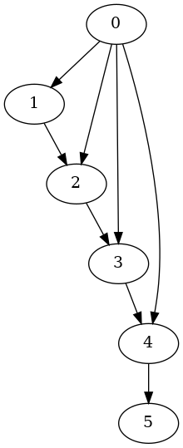
DFS result
What do we need to free before returning the path?
What did we create to run this algorithm?
You might want to add push and pop functions for LLPath
what should the function signatures look like?
Why are we pushing in the order that we are?
0
4
5
1
2
3
[0, 1, 2, 3, 4, 5]
your implementation of Depth-First Search should return the (longer) path 0->1->2->3->4->5, on the Graph 2 problem.

Slide 98
Extra Hwk4 note
This needs to be done in hwk4.c
You can implement a function graph_destroy in graphsearch.c, and add its signature to graphsearch.h
Then you can just call your function!
What should the function signature be?
void graph_destroy(Graph **g);
What should the function do?
Try and reverse the steps from graph_destroy
What order should things be freed in to avoid invalid pointers?

